Slide 1
CAREER OPPORTUNITIES IN THE MARITIME INDUSTRY
1ST JUNE, 2017

Slide 2
OUTLINE
Introduction
Relevant career disciplines
Ship Building and Repairs
On Board a Ship
Terminal Operation
Government Agencies
Other careers in the Maritime Industry
Conclusion

Slide 3
Introduction
The Maritime industry is associated with activities on all vessels used at sea and associated land-based services. Routes include oceans, coasts, seas, lakes, rivers and channels. Maritime in simple terms involves activities that has to do with seaborne trade.
According to the United Nations Conference on Trade and Development (UNCTAD), around 80% of global trade by volume and over 70% of global trade by value are carried by sea and are handled by ports worldwide. These shares are even higher in the case of most developing countries.
This means that most of the things we use on a daily basis were transported by sea.

Slide 4
Introduction Cont.
According to International Maritime Organization (IMO), At the beginning of 2015, the world's commercial fleet consisted of nearly 90,000 vessels, with a total carrying capacity of some 1.75 billion dead weight tonnage (DWT). This fleet is registered in more than 150 nations and is manned by more than a million seafarers of virtually every nationality. It is this fleet that enables the import and export of goods, on the scale necessary to sustain the modern world, to take place.
Career in Maritime begin from where a commodity leaves a warehouse in one country and follow different modes of transportation including the sea with different forms of documentations to another warehouse in another country.

Slide 5
Relevant Career Disciplines In Maritime Sector
Nautical Science
Naval Architecture
Marine Engineering
Electrical/Electronic Engineering
Transport and Logistics Management
Maritime Law
Seafaring
Oceanography
Fisheries Resources Management

Slide 6
Relevant Career Disciplines In Maritime Sector Cont.
Ship Operation Management
Terminal Operation Management
Business Administration
Economics
Geography etc.

Slide 7
Ship Building And Repairs
Naval Architects or Designers: they are mainly responsible for designing the ship, which includes the concept design, stability calculations, resistance estimations, preparation of 3D production model and 2D production drawings.
Marine Surveyor: are responsible for certifying every stage of construction including every weld joint.
Welders and Solderers : are responsible for welding and soldering all the metal structures that make up the ship, which includes the ship’s hull plates, frames, tanks, foundations, pipes, etc.
Plumbers: provide water fittings to all the necessary parts of a ship
Electricians: are responsible for installation of all the electric cables on board the ship, based on the cable routing plans. They also install all the electrical and electronic equipment and navigational equipment

Slide 8
Ship Building And Repairs Cont.
Carpenters: Even though shipbuilding has advanced from the days when wood was used to build ships, carpenters are required to provide furniture and fittings inside the ship.
Quality Control Inspectors: Most commonly called QC Inspectors, they are one of the most skilled people among the workforce in a shipyard, and such roles are usually given to ones with sufficient experience in shipbuilding. They are responsible for carrying out non-destructive tests on weld joints, and carry out dimensional control inspections of every major structure after its installation.

Slide 9
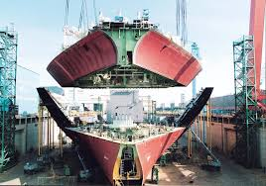
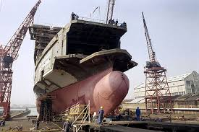
Ship building Yard

Slide 10
On Board a Ship
Captain: Master on board, responsible for the ships activities. He is in charge of navigation, accounting, legal and regulatory compliance, crew hiring and dismissal, personnel management, safety for passengers, crew environment and vessel.
First Officer/ Chief Mate: Working as the head of the deck department, he/she is second in charge of the ship after the Captain. The chief officer supervises the deck crew and ensures that personnel are working in coordination. He/she is also responsible for the safety of the ship and the crew.
Second Officer/Second Mate The Second Officer of a merchant ship is responsible for the navigation of the ship working from the bridge. He/she is also responsible for maintaining navigational equipment on the bridge.

Slide 11
On Board a Ship Cont.
Third Officer/Third Mate: The Third Officer of a merchant ship is responsible for the safety of the ship and the crew. He/she undertakes the responsibilities for maintenance of lifeboats and fire-fighting and signal equipment.
Able Seaman: Able Seaman works as a watch stander or a day worker, depending on the requirement on the ship. When the ship is not moving, he may be asked to perform security related watches.
Ordinary Seaman: Ordinary Seaman or OS is an entry-level position in the deck department. An OS performs various general duties within the deck department. His duties include taking care of general needs of the crew and guarding the ship while in port.

Slide 12
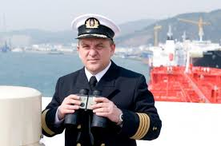
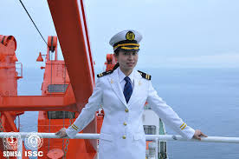
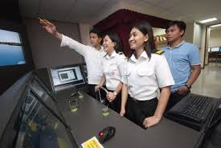
Seafarers

Slide 13
On Board a Ship Cont.
Cadet / apprentice officer: Apprentice officer provides assistance in various duties on a merchant ship, such as maintenance and minor repair duties.
Engineers :They are responsible for maintenance and repair of all electrical and mechanical equipment within the engine room and other areas of the ship.
Stewards: oversees the entire operations within the catering department of a ship. Carry out daily duties in catering such as preparing and serving food, cleaning the catering area, and receiving, issuing, and inventorying the stores
Safety Officer: is responsible for a range of tasks related to safety and security of the ship, crew and cargo.

Slide 14
On Board a Ship Cont.
Fireman: Fireman is responsible for maintenance and handling of firefighting equipment onboard the ship.
Doctor/Physician: He/she is responsible for the treatment of crew members. The position requires current license and extensive experience within primary care, trauma, internal, cardiac, and emergency medicine.
Registered Nurse: Ships hire 1-2 registered nurses with experience in handling accident and emergency cases, cardiac care, trauma, and internal medicine.
Security Personnel: Security Personnel is responsible for the security of the ship, crew and cargo.

Slide 15
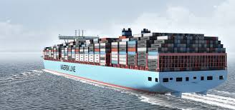
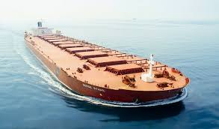
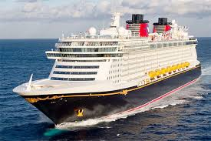
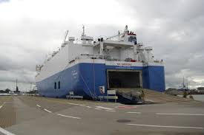
Vessel Types
Container Vessel
Tanker Vessel
Cruise Vessel
RORO Vessel

Slide 16
Terminal Operation
Terminal Operation is a key part of the supply chain and primarily aims to control the movement and storage of various types of cargoes loaded or unloaded from a vessel.
Career opportunities at a port terminal include:
Stevedore: a waterfront manual laborer who is involved in loading and unloading ships.
Crane Operators: operates various equipment available at the port for moving cargoes from the vessel to the storage area and vice versa.
Other career opportunities at the Terminal include accountants, engineers, electricians, security personnel, safety personnel etc

Slide 17
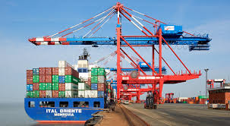
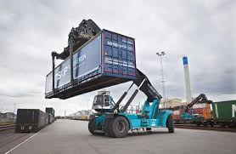
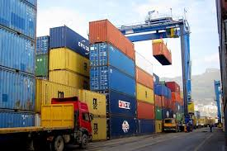
Container Terminal

Slide 18
Government Agencies
Different government agencies regulate activities of the maritime industry to ensure that there are fair practices and adherence to international laws and regulations. Various government agencies in the maritime industry include:
Nigerian Shippers’ Council
Nigerian Port Authority
Nigerian Maritime Administration & Safety Agency
Nigeria Customs Service
Nigerian Inland Waterways Authority
Council for The Regulation of Freight Forwarding in Nigeria
Nigerian Export Promotion Council etc.
Nigerian Navy etc

Slide 19
Other Careers in Maritime Industry Cont.
Maritime Consultant – Maritime consultants are people who have the expertise to advice and suggest better trade routes and address other necessary shipping concerns to individuals and corporations engaged in the maritime business to help them boost, advance and further their business positively. As a career in maritime consultant, the person requires several years of experience in the same field.
Freight Forwarder: A freight forwarder or clearing agent, also known as a non-vessel operating common carrier (NVOCC), is a person or company that organizes shipments for individuals or corporations to get goods from the manufacturer or producer to a market, customer or final point of distribution.
Tourism and Entertainment: enormous opportunity abound in cruise ship business, where tourist and other fun seekers are taken on a cruise around the world.

Slide 20
Other Careers in the Maritime Industry
Shipping Agent – A shipping agent is a person who deals with the transactions of a ship in every port that the ship visits or docks. He or she is a local expert that acts as a representative of the owner of the ship and carries out all essential duties and obligations required by the crew of the ship.
Cargo engineer – The marine work of cargo engineer deals with supervising loading, discharging and conditioning of cargo which is transported by ships. This is one field of engineering which is always in demand.
Ship Chandler – A ship chandler is a person who exclusively deals with supplying commodities to the ship and its crew.
Ship Broker- shipbrokers are specialist intermediaries/negotiators between shipowners and charterers who use ships to transport cargo, or between buyers and sellers of vessels.

Slide 21
Other Careers in Maritime Industry Cont.
Maritime Lawyer – As a maritime lawyer one deals with maritime laws, rules and regulations of the sea, and aspects related to the commercial side of shipping.
Maritime Security – The job of maritime security officer is in great demand lately because of the rise in piracy activities.
Maritime Reporter – write about what is happening in the Maritime Industry.
Trucking/ Rail: Transportation of cargo from the Port to the warehouse and vice versa using trucks or rail.
Warehousing: Opportunities in warehousing includes owning a warehouse, Store keeping, Logistics coordinator, Forklift operator, Inventory manager etc.
Oil and Gas: most exploratory activities of the oil and gas industry is carried out at sea, so they employ a lot of personnel that function in the maritime industry.

Slide 22
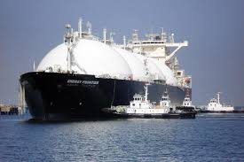
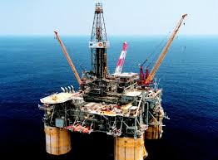
Oil and Gas

Slide 23
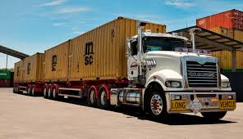
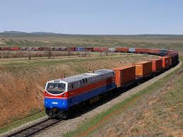
Trucking and Rail

Slide 24
Benefits of choosing a career in the Maritime industry
Multidisciplinary: accommodates graduates from several disciplines of study.
High remuneration: it is one of the highest paying sector.
Global employment: maritime is an international business, if you have a valid certification in any of its area, you can work in any part of the world.
World exposure: you have the opportunity of visiting many part of the world, especially if you work on board a ship.
Enhances professionalisms: it encourages adequate training to acquire certifications that meet acceptable standards.
Regulated life style: maritime business is always time bound, so it makes personnel to be time conscious which also regulates their personal life.

Slide 25
CONCLUSION
The Maritime transportation is the most effective and efficient means to move huge volume of goods across the world, hence, it offers great opportunities to develop a world class career with enormous benefits.

Slide 26
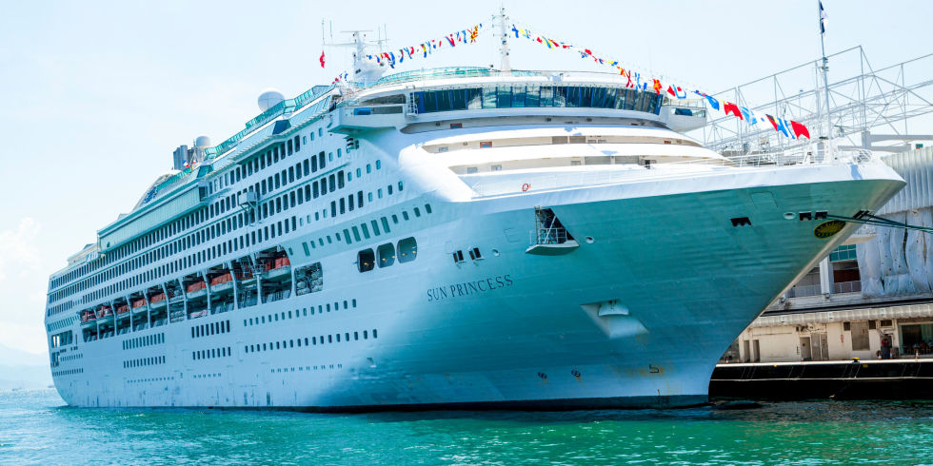
THANK YOU

